Slide 1
From Young Pro to Emerging Leader: How to maximize AFP to build your career!

Slide 2
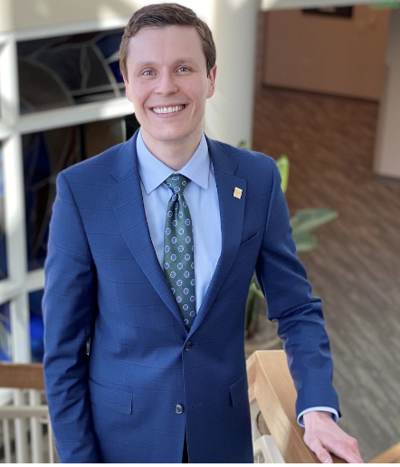
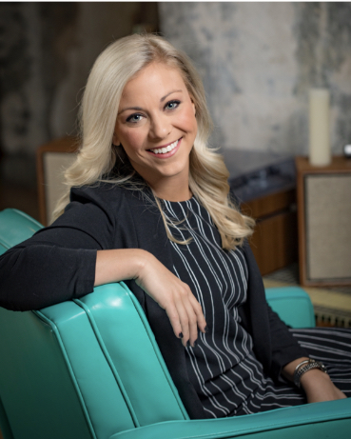
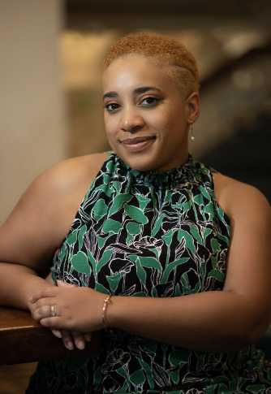
Emerging Leader Presenters
Dzenan Berberovic, M.A., CFRE
Chessie Hayes, CFRE, MPA, CNP
Adrienne Taylor, CFRE, MBA

Slide 3
Here’s our “WHY!”
“Emerging Leaders are jack-of-all-trades, masters of none.”
There is a projected 10-year growth in the fundraising profession of 14%.
Emerging leaders need to strategically maximize their growth potential.

Slide 4
Presentation Outcomes
Be strategic your participation
Master “something” instead of “nothing”
Tips to becoming a continuous learner
Gain skills through other professional activities
Grow your personal and professional brand
Deliberately expand your professional network

Slide 5
Be strategic in your participation
Learn to not try and do “all the things.”
Do a skills audit and then ask yourself:
Will this opportunity increase my current skills?
Will this opportunity help me develop new skills?
Is this worth my time?
Be an expert.
It is okay to say “NO!”
”NO” is a full sentence.

Slide 6
Master “something” instead of “nothing.”
The importance of receiving your CFRE
Receiving your Masters in Public/Nonprofit Administration
Obtaining a certificate in Nonprofit Philanthropy.
Graduate Programs
Free learning and webinars (can be to a specific skill-set)
LinkedIn Learning
AFP Emerging Leader Resources (Korn Ferry Series, Microlearnings)

Slide 7
Adrienne’s tips to becoming a continuous learner
Improve both your strengths and weaknesses.
Maintain “I should invest in myself” mindset.
Learning comes from many different directions.
We can get “rusty” everywhere! - sharpen both hard and soft skills.
Yes, it can be costly, but…ask about sponsorship opportunities.

Slide 8
Gain skills through other professional activities and other membership organizations

Slide 9
Grow your personal & professional brand
What type of fundraiser are you now?
What type of fundraiser do you want to be?
Have your resume and job duties reflect that. If your job description does not entail that type of fundraising, ask you supervisor or find a volunteer opportunity where you can experience that skill set.
You may not have the answer, and that’s okay.
If you don’t, ask yourself, “Where do you see yourself in 5 years or 10 years?”
From there, this will help shape your professional mission and brand. After you create an overall, long-term goal for yourself, create short-term, SMART goals to achieve your personal and professional vision.

Slide 10
Deliberately expand your professional network

Slide 11
Final Thoughts

Slide 12
Resources
AFP Resources:
Emerging Leaders
Micro-Learnings
Mentoring Programs
Local Chapter
Local Young Professional/Emerging Leader Groups
Social Media - follow who you want to “embody”

Slide 13
Q & A

Slide 14
THANK YOU!
Dzenan Berberovic, M.A., CFRE: Dzenan.Berberovic@Avera.org
Chessie Hayes, CFRE, MPA, CNP: FBIGGAM@gmail.com
Adrienne Taylor, CFRE: AdrienneNMcDade@gmail.com

